Slide 1
CE/CS/SE 3354 Software Engineering
Lecture 03
Requirement Engineering

Slide 2
Last class
The iterative model
The prototype model
The agile model

Slide 3
The Iterative Model
Requirement Engineering
Design&
Implementation
&Integration
Testing

Slide 4
Advantages
Users involve earlier
User can give feedback after the first version released
Cheaper to get a working software
Get the first version very fast
The software always work, though not perfect
Important in many cases, e.g., in competitions
Keep refining requirements, and accommodates changes
Cost for requirement changes/errors are small

Slide 5


Disadvantages
More bugs, sometimes may cause severe loss
420k lines of code, 17 errors
260k lines of code, 5770 bug reports
Design is critical to make sure a change does not affect the whole system
Ant has 12,000+ code commits

Slide 6
The Prototype Model
Requirement Engineering
Design&
Build Prototype
Validate Prototype
Formalize
Requirement
Design&
Implementation
Integration

Slide 7
The Prototype Model
Different from waterfall
Good: users involve more (by using prototype), reveal small errors in requirements / design
Not solved: still can not handle frequent requirement changes
Bad: prototype is discarded (waste of some effort, sometimes can be even more expensive than waterfall)

Slide 8
An Agile Method: Extreme Programming
Extreme Programming still uses iterative process model, but goes to extreme

Slide 9
Characteristics of Extreme Programming
Short cycles
User stories
Test-driven development (TDD)
Pair programming
Continuous testing
...

Slide 10
Basic Steps in Software Process Models
Requirement Engineering
Design
Implementation
Integration&
Testing

Slide 11
Today’s class
Requirement Engineering
Concepts
Definitions
Stakeholders
Types of requirements
Process
Elicitation
Analysis
Specification
Validation

Slide 12
Requirements Engineering
First stage of software life cycle
Defines functionalities and constraints
Produces a document, software requirements specification (SRS) to bridge customers and developers
Customers provide high level ideas
Software developers need a more detailed specification

Slide 13
Software Requirements
Requirements are means of communication with customer and other stakeholders
[by Helene Wong, PhD thesis, 1994]

Slide 14
Stakeholders
People who support, benefit from, or affected by a software project
Stakeholders may include
Customers
Users
Managers
System administrators
Consultants
Software engineers
...

Slide 15
Stakeholders Example
A medical system for sharing information among medical care providers
Who are the stakeholders?

Slide 16







Stakeholders Example (Cont’d)
...

Slide 17
Types of Requirements: Functionalities
Functional requirements
What is the system supposed to do
Mapping from input to output
Non-functional requirements
Performance
Resource Consumption
Usability
Reliability
Robustness
Portability
…

Slide 18
Measures of Non-functional Requirements
Property | Example Measure
Performance | Processed transactions per second User/event response time
Resource Consumption | Mbytes Number of ROM chips
Usability | Training time Number of help frames
Reliability | Mean time frame between failures Rate of failure occurrence
Robustness | Time to restart after failure Percentage of events causing failure Probability of data corruption on failure
Portability | Percentage of target dependent statements Number of target systems

Slide 19
Types of Requirements: Constraints
Process constraints
a restriction on the techniques or resources that can be used to build the system
Design constraints
a design decision such as choice of platform or interface components

Slide 20

Types of Requirements: Example
Functional requirement: The email must be sent when requested
Non-Functional requirement: The latency should not be more than one hour
Process constraint: Two developers will be involved in this project
Design constraint: The project will be implemented for the Android platform

Slide 21
Requirements Are Important
The hardest single part of building a software system is deciding precisely what to build.
No other part of the conceptual work is as difficult as establishing the detailed technical requirements, including all interfaces to people, to machines, and to other software systems.
No other part of the work so cripples the resulting system if done wrong. No other part is more difficult to rectify later.
[by Frederick Brooks, “No silver bullet: essence and accidents of software engineering”, 1986]

Slide 22
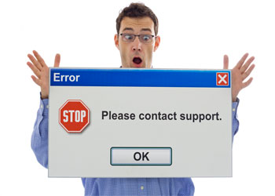
Requirements Are Important (Cont’d)
80% of software errors are requirements errors
Here software errors are defined as errors detected after unit testing – i.e., in integration testing and after the software is released
Most errors can be traced to unknown, wrong, or misunderstood requirements

Slide 23
Requirements Are Important (Cont’d)
As time goes by, requirements errors are more expensive to fix
Stage discovered | Relative repair cost (p.day)
Requirements | 0.1 – 0.2
Design | 0.5
Coding | 1
Unit test | 2
Acceptance test | 5
Maintenance | 20

Slide 24
Today’s class
Requirement Engineering
Concepts
Definition
Stakeholders
Types of requirements
Process
Elicitation
Analysis
Specification
Validation

Slide 25
Requirement Engineering Process
Elicitation
Analysis
Specification
Validation

Slide 26
Requirements Engineering Process
Determine the requirements of a system, and specify what behavior is realized
Work with stakeholders to elicit the requirements
Analyze and model the requirement
Document the requirements in a software requirements specification
Validate the software specification

Slide 27
Requirement Engineering Process
Elicitation
Analysis
Specification
Validation

Slide 28
Requirements Elicitation
Elicitation is to gather
Functions that the system should perform
Non-functional requirements that the system should exhibit
Elicitation is critical but difficult
Customers are not good at describing what they want
Software engineers are not good at understanding what customers want
Customers and software engineers speak different languages

Slide 29
Elicitation Approaches
Brainstorming
Interviewing
Ethnography
Strawman/Prototype

Slide 30
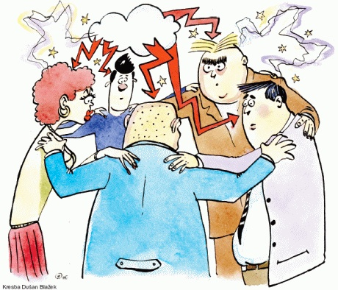
Brainstorm

Slide 31
Brainstorm
Gather stakeholders, collect ideas from them and prune ideas
Organization Tips:
Keep the number of participants “reasonable”
Invite the most creative people to multiple sessions

Slide 32
Brainstorm - the Storm
Purpose
Generate as many ideas as possible
Quantity, not quality, is goal at this stage
Common Rules
No criticism or debate
Write down all ideas where all can see
No self-censor or wondering if an idea is practical
Original list does not get circulated outside of the meeting

Slide 33
Brainstorm – the Calm
Purpose
Review, consolidate, combine, clarify, and expand
Rank the list by priority somehow; choose a winner
Common Rules
Go over the list and explain ideas more carefully
Categorize into “maybe” and “no” by pre-agreed consensus method (e.g., voting, priority points)
Be careful about time: meetings should have a fixed time frame (90-120 minutes)

Slide 34
Brainstorm: Pros & Cons?
Pros
Cons
No Preliminary Knowledge Preparation
Comprehensive gathering of ideas, solve conflicts earlier
No clear mission, costly for gathering, may take a long time
People from different field may feel difficult to interact

Slide 35
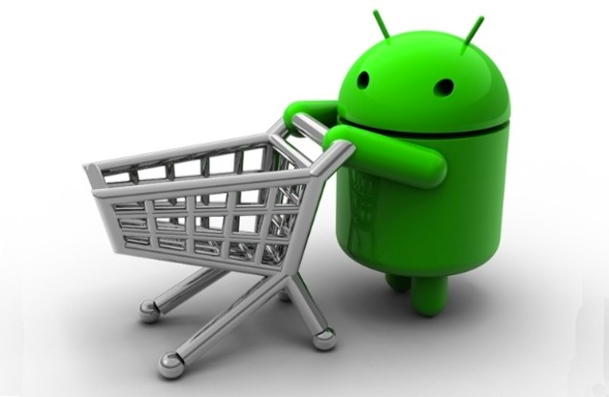
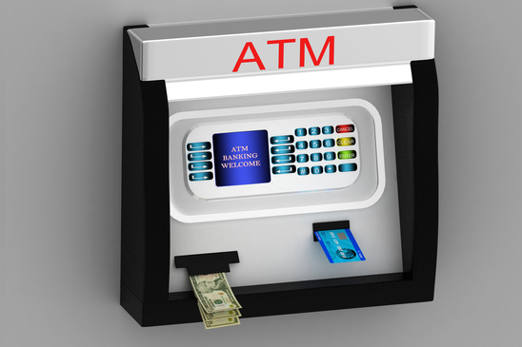
Brainstorm Applicability
vs.
Good: Startup software, general topic, e.g. personal shopping software
Not good: Domain experts/systems exist, limited resources, e.g., ATM banking system

Slide 36

Interviews

Slide 37
Interviews
Formal or informal interviews with stakeholders
Types of interview
Closed interviews: based on pre-determined list of questions
Open interviews: issues are explored with stakeholders.
Effective interviewing
Prompt the interviewee to get discussions going using a requirement proposal
Be open-minded, avoid pre-conceived ideas

Slide 38
Interviews in practice
Mostly used approach for requirement elicitation: in almost every project
Normally a mix of closed and open interviews

Slide 39
Interviews: Pros & Cons
Pros
Cons
Simple to apply in practice
Usually can get some progress
Interviewee may ignore details because they are too familiar with them
Interviewee may have too little knowledge in computer science to express their ideas effectively

Slide 40

Talk-based Requirement Gathering
Terminology Problem
Sometimes people fails to articulate what they want
Too familiar to come up with
Fail to go to the details
Practice-based requirement gathering

Slide 41

Ethnography

Slide 42
Ethnography: Origin
A social scientist spends a considerable time observing and analyzing how people actually work.
People do not have to explain or articulate their work.
Social and organizational factors of importance may be observed.

Slide 43
Ethnography for Requirement
Discover requirements by observing the way that people actually work
This include the interaction and collaboration between people doing their work
Talks, emails, meetings, …
Gathering of real data generated in the actual work
reports
filled forms
emails, …

Slide 44
Ethnography: Pros & Cons?
Pros
Cons
Reveal real requirements, avoid problems caused by imprecision in oral/written expression
Require little preliminary knowledge
May take a long time to finish an effective observation
May have legal or privacy issues
Can only observe what is happening at present, but people’s behavior may change with the new software
Frequently used in practice when there is an existing system in use

Slide 45

Strawman/Prototype

Slide 46
Strawman/Prototype
Prototype: write a prototype software for requirements
Strawman: something to convey ideas without coding
GUI
Web pages
Flow chart of UIs

Slide 47
Strawman: flow chart

Slide 48
Strawman/Prototype: Pros & Cons
Pros
Cons
Can go to details
Easy to link requirements to design/implementation
Most accurate
High cost in preparation
Require preliminary knowledge
Pre-assumptions may limit the scope of the software

Slide 49
Combination of Different Approaches
Brainstorm + interview
Raise some questions, then ask more people
Interview + strawman/prototype
Talk to interviewee with a strawman/prototype
Interview + ethnography
Asking people after observing their work
Prototype + ethnography
Observe how people work on a prototype

Slide 50
Requirement Engineering Process
Elicitation
Analysis
Specification
Validation

Slide 51
Requirements Analysis
Requirements analysts have to understand the system from each stakeholder's point of view
Stakeholders have different views of the system
Requirements analysts resolve conflicting views
Requirements analysts prioritize requirements
Essential requirements
Desirable requirements
Optional requirements

Slide 52
Requirements Analysis
Goal
Determine the scope of the software
Categorization, negotiation, and decision:
Few established fixed approaches
Large amount of mental work based on domain knowledge
Project manager/customer representative often plays the key role

Slide 53
Today’s class
Requirement Engineering
Concepts
Definition
Stakeholders
Types of requirements
Process
Elicitation
Analysis
Specification
Validation

Slide 54
Next Class
Requirement Specification & Validation
Use case diagram (A good way to specify requirements)

Slide 55
Thanks!

